Slide 1
ENGI 301 <Music Bracelet> PCB Proposal
<Nov 16th 2021>
<Lisa Zhu>

Slide 2
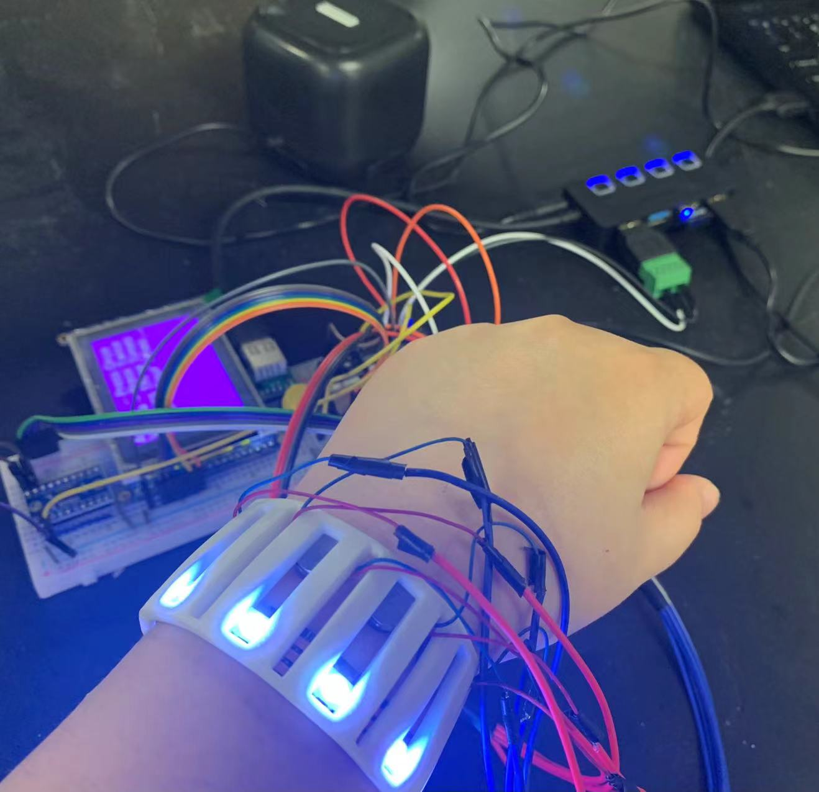
Background Information
What is being proposed?
Lisa-zhu-zz65/ENGI301 (github.com)
Music Bracelet - Hackster.io
What changes (if any) are you going to make based on your prototype?
Change the USB speaker to a Bluetooth speaker
Get power from a battery instead of wall outlet
Reduce the size of the screen
Smaller Breadboard

Slide 3
System Block Diagram
Pocket Beagle
Battery
VIN
VOUT
RGB LED Strip
SPI
GND
PWM
Vibrating Mini Motor Discs
USB breakout board
Bluetooth Adaptor
USB1
Button
GPIO
SPI
Adafruit 1.8" TFT Display Breakout and Shield

Slide 4
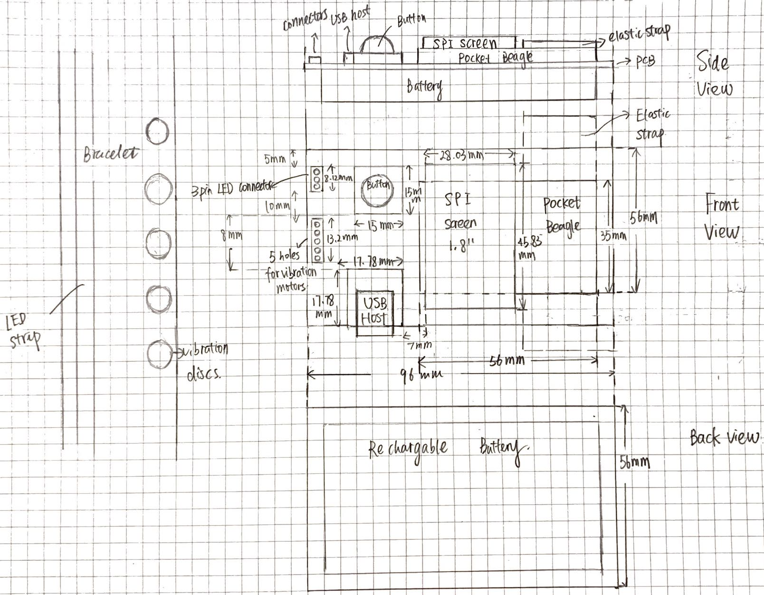
Mechanical Block Diagram

Slide 5
Components Required
Create a list of all the components that you require for the PCB
USB Host connector
TXS0108E Level Shifter
Power connector
3-pin 100-mil Strip LED connector
LED strip
Button
Bluetooth adaptor
1.8" TFT Display Breakout and Shield
Vibration discs

